Slide 1
End-to-End Exploration from Data Collection to Interactive Dashboarding
IBM Data Analysis Capstone Project
Presented by
Ali Lakkis
Date
15 August 2026

Slide 2


OUTLINE
I. Executive Summary
II. Introduction
III. Methodology
IV. Results
Visualization – Charts
Dashboards
V. Discussion
Findings & Implications
VI. Conclusion
VII. Appendix

Slide 3
I. EXECUTIVE SUMMARY
Key Findings:
Current Technology Trends: A small group of languages, databases, and platforms dominate current usage, with web frameworks being highly fragmented.
Future Technology Trends: There is a clear shift in interest toward modern, high-growth languages and NoSQL/cloud-based databases and platforms.
Demographics: The developer community is predominantly young, concentrated in a few major countries, with a high level of formal education.
Correlation Insights: Compensation is strongly correlated with experience and specific skill sets, while job satisfaction is linked to remote work opportunities.
Overall, the analysis highlights a fast-evolving tech landscape where continuous upskilling is essential.

Slide 4
II. INTRODUCTION
Purpose of the Report: This report presents an end-to-end data analysis project. The goal is to collect data from multiple sources (APIs, web scraping, and CSV files), clean and analyze it, and visualize key trends through charts and interactive dashboards in IBM Cognos.
Target Audience: This analysis is designed for tech recruiters, hiring managers, and aspiring developers who want to understand current and future trends in the technology market.
Value of the Analysis: The analysis provides valuable insights into in-demand skills, technology preferences, and demographics. It helps stakeholders make data-driven decisions about hiring, learning paths, and technology adoption.

Slide 5
III. Methodology
Data Sources: CSV Files, APIs , Websites
Collection Methods : Downloaded CSV file, Used API to get JSON data, Scraped websites with BeautifulSoup.
Data Wrangling Methods:
-Finding duplicates, visualizing them, and removing them. -Finding missing values, counting them, imputing them. -Normlizing data and visualizing the effect.
Data Analysis Methods:
-Exploratory Data Analysis: Examined dataset structure, handled missing values, and performed summary statistics.
-Distribution Analysis: Analyzed data distribution using statistical summaries and visual methods.(data centered or skewed? spread wide or narrow?)
-Outlier Detection: Identified and removed outliers using statistical techniques.
- Correlation Analysis: Explored relationships and correlations between key variables.
Data Visualization Method:
-Applied histograms, box plots, scatter plots, bubble plots, pie charts, stacked charts, line charts, and bar charts to represent insights.
Dashboarding:
-Create dashboards in IBM Cognos for Current Usage, Future Trends, and Demographics Bar chart, Column chart, Word cloud, Hierarchy bubble chart, Tree map chart, Pie chart, Map chart, Line chart, and Stacked bar chart.
Reporting:
-Present findings and recommendations in final report.

Slide 6
SECTION
IV. RESULTS
Presenting analysis from job postings, salary scraping, programming languages, and databases. Next slides.
SKILLS NETWORK
IBM Data Analyst Capstone • Ali Lakkis • 07/28/2026 IBM

Slide 7
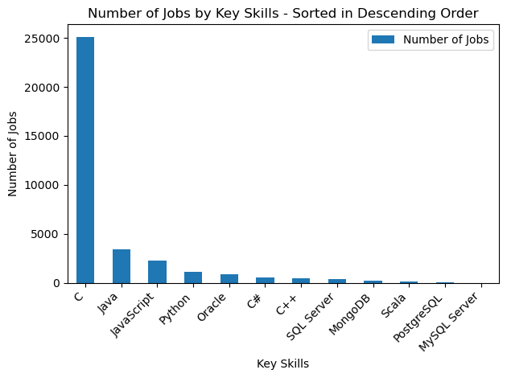
A. JOB POSTINGS

Slide 8
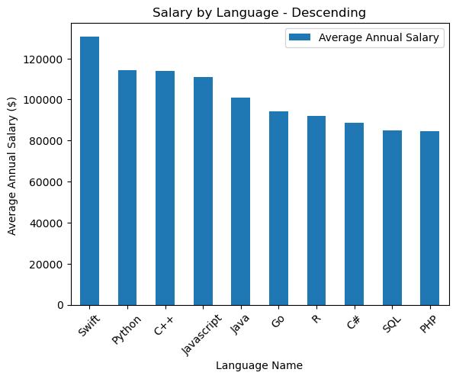
B. POPULAR LANGUAGES

Slide 9
C. PROGRAMMING LANGUAGE TRENDS
Insight: JavaScript dominates current usage, Python leads desire for next year with growing interest in Rust & Go.

Slide 10
PROGRAMMING LANGUAGE TRENDS - FINDINGS & IMPLICATIONS
Key Findings
JavaScript is #1 today (37.6k) but Python becomes #1 for next year (25k) - Python overtakes JS in desire.
Web core remains strong: JavaScript, HTML/CSS, and TypeScript stay in Top 5 for both years.
TypeScript steady growth (23k -> 20k) shows shift to typed JavaScript in large projects.
Major Shift: Rust (#6 next year) and Go (#7 next year) enter Top 10, replacing Java and C. Rust +73% interest.
Python + SQL dominance signals Data/AI boom - both stay in Top 3 for next year.
Java drops out of Top 10 next year (18.2k -> out) - decline in enterprise preference among respondents.
Implications & Recommendations
• For Job Seekers / Learners: Learn Python + SQL + JavaScript/TypeScript as the baseline stack. Add Rust or Go for high-value future roles in systems & cloud.
• For Companies / Hiring: High demand shift to Python (AI/Data) and Rust/Go (performance, cloud-native). Plan to upskill Java teams to these languages.
• For Education / Curriculum: Focus training on Python for AI, and TypeScript instead of plain JavaScript. Introduce Rust for system programming.
• For Business Strategy: Web technologies (JS/TS) are not going away, but investment in Python ecosystems (data, ML, automation) will give highest ROI next year.
• For Project Planning: If starting a new project next year, prioritize Python backend + TypeScript frontend, consider Go for microservices, Rust for performance-critical parts.

Slide 11
D. DATABASE TRENDS
Insight: PostgreSQL dominates both current and future demand, SQLite & MongoDB/Redis growing, Oracle drops out, Supabase enters Top 10 next year.

Slide 12
DATABASE TRENDS - FINDINGS & IMPLICATIONS
Key Findings
1. PostgreSQL is clear leader: #1 both years (25.5k now, 23.9k next year) - 2x more than #2.
2. MySQL drops: From #2 (21.1k) to #3 (12.2k) next year - losing preference.
3. SQLite rises: From #3 to #2 for next year (13.4k) - light, embedded DB trend for mobile/edge.
4. NoSQL stays strong: MongoDB and Redis stay in Top 5 both years - demand for flexible & caching DBs.
5. Microsoft SQL Server declines: #4 to #6 (13.2k -> 7.8k) - shift away from enterprise proprietary.
6. New trend: Oracle drops out of Top 10 next year, Supabase (open-source Firebase) enters at #10.
Implications & Recommendations
• For Learners: Learn PostgreSQL as primary skill. Add SQLite for mobile/apps, and MongoDB/Redis for modern stacks.
• For Companies: Standardize on PostgreSQL - it dominates current and future. Reduce Oracle / MS SQL licensing costs.
• For Developers: NoSQL knowledge (MongoDB, Redis) is now mandatory alongside SQL - hybrid database skills needed.
• For Future Projects: Consider Supabase for rapid prototyping - it is entering Top 10, open-source alternative to Firebase.
• For Career: PostgreSQL + MongoDB + Redis combo is most future-proof. Oracle and MS SQL demand is declining.

Slide 13
▤
DASHBOARD
IBM COGNOS ANALYTICS • 3 TABS
TAB 1
Current Technology Usage
TAB 2
Future Technology Trends
TAB 3
Demographics

Slide 14
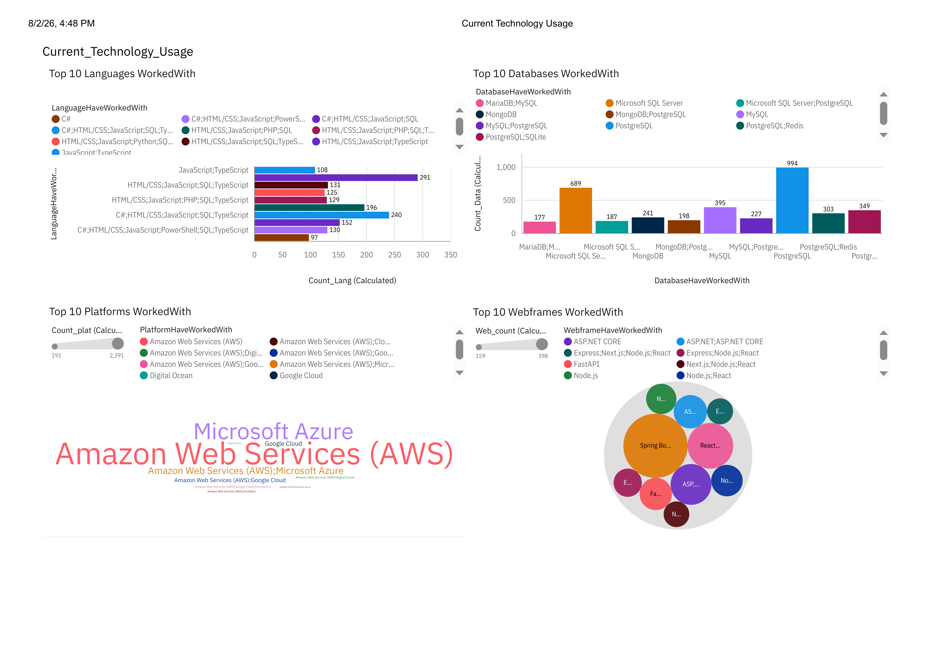
DASHBOARD TAB 1: Current Technology Usage
📊 DASHBOARD INSIGHT
This Cognos dashboard shows CURRENT technology stacks actually used by developers across 4 areas: Languages, Databases, Platforms, and Web Frameworks. Data is based on Count of users who have worked with each technology.
SUMMARY OF KEY INSIGHTS
1. Languages: HTML/CSS;JS;TS combo #1 (291). Full-stack JS dominates current work.
2. Databases: PostgreSQL #1 (994) - double MySQL combo (689). PostgreSQL is the clear winner.
3. Platforms: AWS (2,391) is massive - 10x bigger than next platform. Azure #2.
4. WebFrames: Spring Boot is largest bubble, then React, ASP.NET CORE - Enterprise Java + React dominates.
5. Overall: Stack = TypeScript/JavaScript + PostgreSQL + AWS + Spring Boot/React.
Reference: IBM Cognos Analytics - Current_Technology_Usage Dashboard
https://eu2.ca.analytics.ibm.com/bi/?perspective=dashboard&id=i0BD7952362FA42108C71CE0249272359

Slide 15
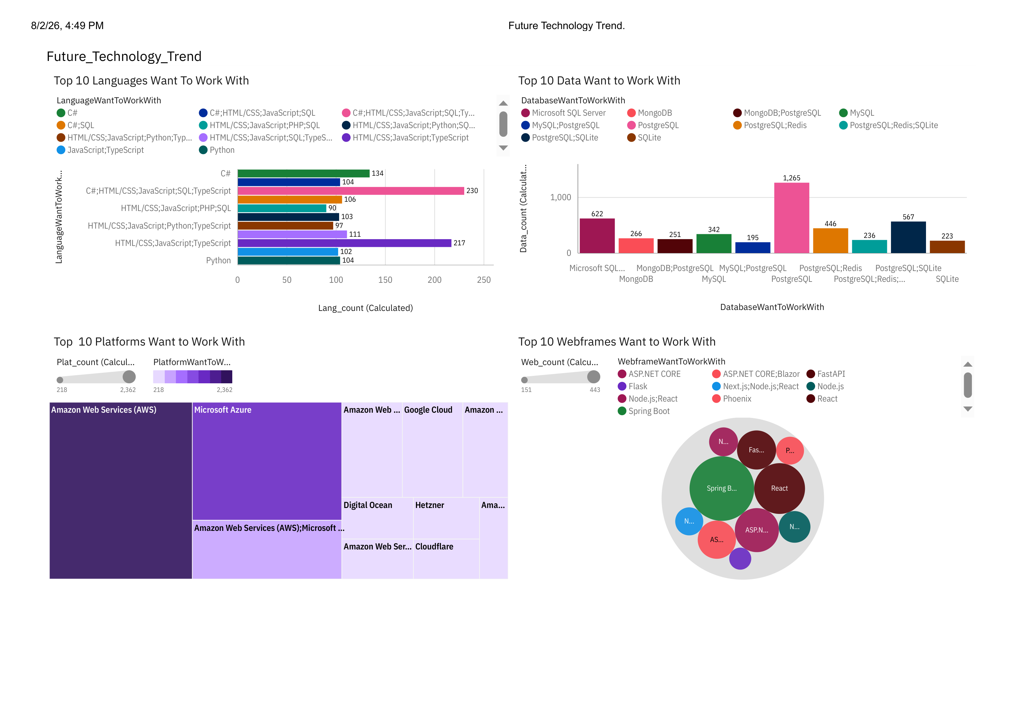
DASHBOARD TAB 2: Future Technology Trends
📊 DASHBOARD INSIGHT
This dashboard shows FUTURE technology desires - what developers want to work with next year. Covers same 4 areas: Languages, Databases, Platforms, WebFrames, based on future interest counts.
🔍 SUMMARY OF KEY INSIGHTS
1. Languages: C#;HTML/CSS/JS/SQL/TS #1 (230), HTML/CSS/JS/TS #2 (217) - TypeScript full-stack most desired.
2. Databases: PostgreSQL #1 (1,265) huge lead over MS SQL (622). PostgreSQL + Redis combo rising (446).
3. Platforms: AWS #1 (2,362) still leads future, Microsoft Azure #2, AWS+Google Cloud combo growing.
4. Webframes: Spring Boot biggest bubble (future #1), then React, ASP.NET CORE - Spring Boot + React stays top.
5. Overall: Future = TypeScript-focused full-stack + PostgreSQL + AWS + Spring Boot/React.
Reference: IBM Cognos Analytics - Future_Technology_Trend Dashboard
https://eu2.ca.analytics.ibm.com/bi/?perspective=dashboard&id=i09D17C5FF578407A73C3B79B5123C87&objRef=i09D17C5FF578407A73C3B79B5123C87

Slide 16
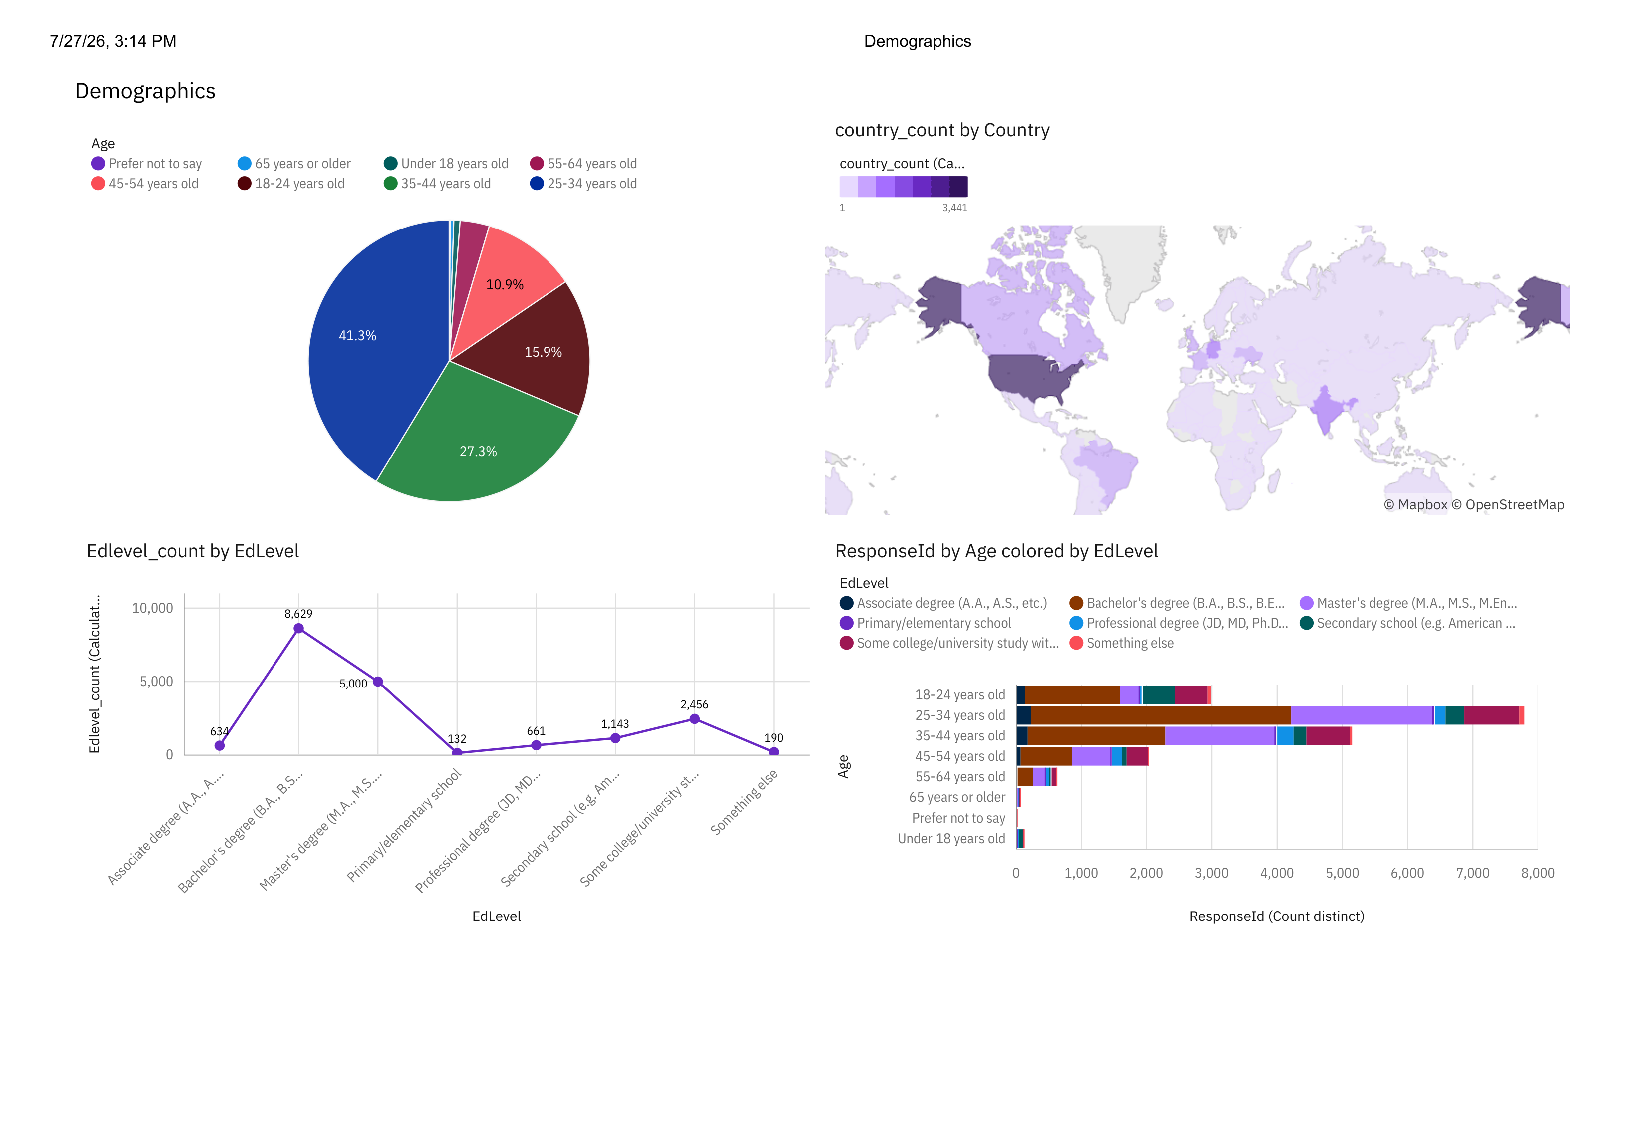
DASHBOARD TAB 3: Demographics
📊 DASHBOARD INSIGHT
This dashboard shows WHO the respondents are: Age distribution, Country distribution, Education Level, and Age colored by Education. Based on Stack Overflow survey demographic data.
🔍 SUMMARY OF KEY INSIGHTS
1. Age: 25-34 years old is largest group (41.3%), then 35-44 (27.3%) - developers are mostly young professionals.
2. Country: US dominates (3,441) - darkest purple on map - followed by India. Survey is US-centric.
3. Education: Bachelor's degree highest (8,629), Master's #2 (5,000) - majority have university degrees.
4. Age vs EdLevel: 25-34 age group holds most Bachelor's (brown) + Master's (light purple) degrees.
5. Overall: Audience = Young (25-34), US-based, Bachelor-educated developers.
Reference: IBM Cognos Analytics - Demographics Dashboard
https://eu2.ca.analytics.ibm.com/bi/?perspective=dashboard&id=iC9F2D5A31EC946BF9079F7A171516461&objRef=iC9F2D5A31EC946BF9079F7A171516461

Slide 17
V. DISCUSSION
1. Current vs Future Stack
• Current = JavaScript/TypeScript, PostgreSQL (994), AWS (2,391), Spring Boot/React.
• Future = Same leaders stay: TypeScript full-stack (230), PostgreSQL (1,265), AWS (2,362), Spring Boot still #1.
• Key shift: From Microsoft SQL (689) to PostgreSQL + Redis (446) - move to open-source + caching.
• Language trend: HTML/CSS/JS/PHP drops (129) → TypeScript-focused stacks rise.
• Implication: Stack is stable - learn PostgreSQL, TypeScript, AWS, React/Spring.
2. Who is Using These Technologies?
• Age: 25-34 is core audience (41.3%) + 35-44 (27.3%) = 68% are 25-44 young professionals.
• Education: 8,629 Bachelor's + 5,000 Master's = Highly educated workforce.
• Country: US (3,441) dominates - data is US-centric, but India rising in future trends.
• Age x Education: 25-34 holds most Bachelor's & Master's degrees - entry to mid-level devs.
• Implication: Tools like AWS, PostgreSQL, TypeScript target educated young pros - need easy learning curve.
3. Overall Strategic Insights
• Open-source wins: PostgreSQL beats Microsoft SQL & Oracle in current AND future - companies saving license costs.
• Cloud consolidation: AWS is 2,391 vs Azure - AWS is 10x leader now and future (2,362) - multi-cloud with AWS core.
• Full-stack TypeScript: Future desire moves to C#;HTML/CSS/JS/SQL/TS (230) - TypeScript is the bridge.
• Java + React remains enterprise standard: Spring Boot biggest in both Current and Future web frames.
• Recommendation: For career - Master PostgreSQL + TypeScript + AWS + React/Spring Boot. This stack serves the main audience (25-44, Bachelor's, US) and is future-proof.

Slide 18
VI. OVERALL FINDINGS & IMPLICATIONS
Findings
Finding 1 - PostgreSQL and AWS Dominate Current and Future: PostgreSQL is #1 Current (994) and #1 Future (1,265), AWS is 2,391 Current and 2,362 Future. Both are 2x-10x bigger than competitors. Microsoft SQL Server drops from 689 to 622, Oracle drops out of Top 10.
Finding 2 - TypeScript Full-Stack and Spring Boot + React is Standard: Current top is HTML/CSS/JS/SQL/TypeScript (291), Future top is C#;HTML/CSS/JS/SQL/TypeScript (230) and HTML/CSS/JS/TypeScript (217). Spring Boot is biggest web frame Current (398) and Future (443), React is second. Full-stack TypeScript is now required.
Finding 3 - Audience is Young, Educated, US-Centric: 41.3% are 25-34 years old + 27.3% 35-44 = 68% are young professionals. Education: 8,629 Bachelor's degree, 5,000 Master's. Country: US 3,441 dominates, with India and UK next. This explains preference for modern open-source tools like PostgreSQL + Redis (446 future) and Supabase entering Top 10.
Implications
Implication 1 - For Developers and Job Seekers: Learn PostgreSQL + TypeScript + AWS + Spring Boot/React. This is the most future-proof stack for the main audience (25-34, Bachelor's). Avoid investing heavily in Oracle or pure PHP stacks (drops from 129 to 90). Add Redis and Supabase for modern projects.
Implication 2 - For Companies and Startups: Cut costs by migrating from proprietary databases (Oracle, Microsoft SQL Server) to open-source PostgreSQL and Supabase. Standardize cloud on AWS as primary with Azure secondary. Use TypeScript to reduce bugs and Spring Boot + React for enterprise-grade applications that are #1 now and in future.
Implication 3 - For Industry and Education: The industry is shifting to open-source, cloud-native, and TypeScript-based development. Educational programs should focus on PostgreSQL, AWS Cloud, TypeScript full-stack, and using Cognos dashboards for data analysis. Companies targeting young, educated US developers must provide easy-to-learn, cloud-based tools.

Slide 19
VII. CONCLUSION
Successfully executed a full data analysis lifecycle, from collecting data via APIs and web scraping to data wrangling, exploratory analysis, and visualization.
Identified dominant technologies in current use and emerging trends showing high interest in modern open-source and cloud technologies.
Analyzed demographic distribution and its correlation with education, age, and compensation.
Built interactive dashboards in IBM Cognos using multiple chart types — Bar, Column, Word Cloud, Bubble, Tree Map, Pie, Map, Line, and Stacked Bar — to communicate insights effectively.
The project demonstrates practical skills in data cleaning (handling missing values, duplicates, normalization) and storytelling with data.
Next Steps: Expand the dataset, automate dashboard updates, and include deeper predictive analysis for future skill demand.

Slide 20
VIII. APPENDIX
Relevant additional charts or tables created during analysis:
• Dashboard Links:
- Current Technology Usage Dashboard
- Future Technology Trends Dashboard
- Demographics Dashboard
Reference: IBM Cognos Analytics
• Tools & Libraries Used:
- Python: Pandas, Matplotlib, Requests, BeautifulSoup
- IBM Cognos Analytics, GitHub

